Slide 1
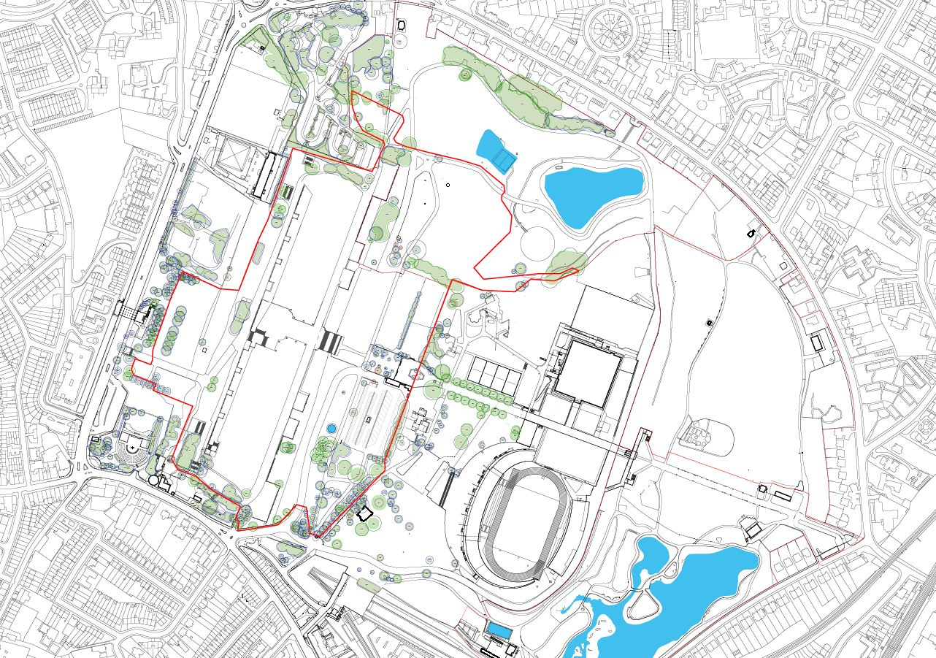
The outlined area will be closed from Monday, 6th September 2021 until Wednesday, 15th September when certain areas will be accessible again. Further information of which areas will be accessible will follow.
If you have any queries, please call our Resident Hotline:
Build & Break Days: 07940 499 510 (from 08:00hrs – 20:00hrs)
Event Days: 020 8396 7701

